Slide 1
SWIFTLOG LOGISTICS
EXECUTIVE BRIEFING
SUPPLY CHAIN & OPERATIONS ANALYTICS
Executive Insights & Strategic Optimization Roadmap
End-to-end performance diagnostic, operational friction analysis, and commercial growth strategy for Nigerian hub operations.
Aisha Mutiu Eniola
$14.81M
5,000
1,000
Lead Data Analyst Intern | AnalystLab Africa
TOTAL REVENUE
TOTAL ORDERS
ACTIVE CLIENTS

Slide 2

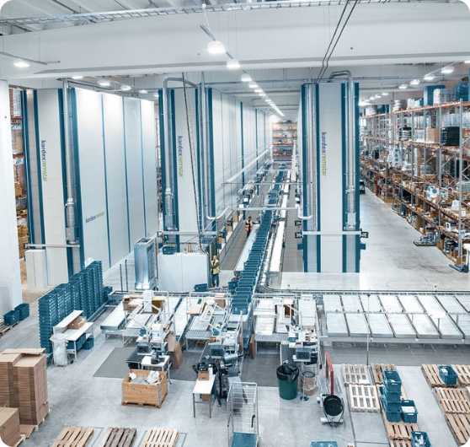
01. COMPANY FOOTPRINT
Business Overview — SwiftLog Logistics
Multi-City Freight & Distribution
Regional Commercial Footprint
Primary hub distribution operating across key Nigerian urban markets: Lagos, Ibadan, Kano, and Abuja.
Category Mix & Scale
Managing 250 active SKUs across three primary verticals: Fashion (37.5%), Electronics (32.2%), and Food (30.2%).
Operational Throughput
56,000 inventory units in circulation supporting over 3,000 completed shipments across regional routes.

Slide 3




02. SCOPE & MISSION
Project Objectives & Analytical Focus
Power BI Analytics Suite
Financial Velocity
Fulfillment Health
Inventory Control
Client Retention
Analyze top-line revenue trajectories, transaction value patterns, and order revenue generation.
Diagnose dispatch lag, last-mile delay causes, and returned delivery friction points.
Monitor stock movement speed, prevent critical stockouts, and manage warehouse holding capacity.
Profile regional purchasing concentration, repeat order habits, and customer loyalty cohorts.
$2.94M Avg Order Volume
40% Delivery Delay Rate
224.12 Turnover Ratio
5.05 Avg Orders / Client

Slide 4
03. TECHNICAL ARCHITECTURE
Data Pipeline & Modeling Workflow
Power Query & DAX Engine
01
02
03
04
Multi-Source Extraction
ETL Standardization
Star Schema Modeling
DAX Analytics
Ingested operational tables covering Orders, Clients, Inventory SKUs, Shipments, and Vendors.
Power Query cleaning: resolved null values, corrected city spelling, and standardized timestamp formats.
Established 1:N relational links between central fact tables and dimensional lookup tables.
Engineered custom metrics for Revenue, Delivery Delay %, Stock Turnover, and Order Velocity.

Slide 5
04. INTERACTIVE BI SUITE
Dashboard Architecture — 5 Specialized Pages
Power BI Navigation
1. Executive Overview
2. Client Analytics
3. Inventory Control
High-level revenue tracking, monthly growth trends, and order return root causes.
City-level revenue distribution, purchase frequencies, and top account performance.
Warehouse capacity gauges, stock movement speed, and automated reorder alerts.
4. Shipment & Delivery
5. Vendor Performance
On-time delivery rates, transit delay analysis, and last-mile route tracking.
Supplier fulfillment efficiency, lead time rankings, and category breakdown.

Slide 6
05. OPERATIONAL PERFORMANCE
Executive KPI Performance Scorecard
Validated Power BI Metrics
Metric Domain | Key Performance Indicator | Measured Value | Operational Benchmark & Status
Financials | Total Commercial Revenue | $14.81M | Strong top-line revenue execution
Order Volume | Placed vs. Shipped Orders | 5,000 / 3,000 | 40% fulfillment shortfall identified
Customer Base | Total Clients & Order Frequency | 1,000 / 5.05 | High repeat purchase account loyalty
Inventory Velocity | Stock Turnover / Total Units | 224.12 / 56K | Rapid stock rotation throughput
Fulfillment SLA | Delayed Shipments Rate | 1,200 (40.0%) | Critical bottleneck requiring intervention

Slide 7
06. ANALYTICS INSIGHTS
Revenue Dynamics & Customer Segmentation
Executive Dashboard Analysis
$14.81K
37.5%
2,000
Average Revenue Per Client Account
Fashion Share (Top Revenue Vertical)
Orders Unfulfilled / Pending Backlog
Regional Concentration
Return Drivers Breakdown
Top-line revenue generation is heavily concentrated in commercial hubs: Ibadan, Kano, Lagos, and Abuja.
Late Deliveries (42%) represent the largest single cause of returned packages across transit routes.
High repeat purchasing rate (5.05 avg) underscores strong client retention across regional centers.
Secondary drivers: Wrong Item Shipped (33%) and Damaged Packaging (25%) during last-mile transit.

Slide 8


07. OPERATIONS DIAGNOSTIC
Operational Bottlenecks & Inventory Risks
Logistics & Warehouse Diagnostic
Transit Delay Friction
1,200 Delayed
40% of shipments experience delivery delays, primarily concentrated on long-haul transit routes connecting Kano and Lagos hubs.
Critical Low-Stock Alerts
10 High-Risk SKUs
Identified 10 fast-moving SKUs (e.g., P078, P034, P233) approaching buffer limits, threatening potential stockouts.
Stock Velocity vs. Capacity
224.12 Turnover
High rotation velocity proves product demand, but uneven warehouse stock allocations restrict regional fulfillment speed.

Slide 9

08. STRATEGIC ROADMAP
Supply Chain & Logistics Recommendations
Operational Action Plan
1. Last-Mile SLA Enforcement
2. Warehouse Barcode Scanning
3. Automated Stock Triggers
Institute strict dispatch cut-offs and financial penalty clauses for third-party logistics partners to curb the 40% delivery delay rate.
Deploy automated pre-dispatch barcode verification to completely eliminate the 33% "Wrong Item Shipped" customer return root cause.
Configure dynamic DAX alert thresholds in Power BI to trigger automated reorder requests when high-volume SKUs reach safety limits.
Target: Under 15% Delay Rate
Target: Zero Packing Errors
Target: Zero Out-of-Stock Events

Slide 10

09. COMMERCIAL GROWTH
Commercial Strategy Recommendations
Revenue & Partner Optimization
1. VIP Account Loyalty Tiering
2. Supplier Volume Contracts
3. Regional Hub Stock Rebalancing
Establish priority fulfillment protocols and dedicated account managers for high-frequency clients across Lagos and Ibadan.
Leverage strong unit sales velocity with key vendors (Supplier 1, Supplier 10) to negotiate volume rebates and preferred lead times.
Reallocate inventory holding ratios toward Kano and Lagos fulfillment centers to align stock placement directly with regional demand.
Protects Top 20% Revenue Accounts
Lowers Cost per Unit Ingested
Reduces Transit Lead Times

Slide 11

10. PROJECTED RETURN
Expected Business Impact & Projected ROI
Strategic Value Delivery
25% Reduction in Delivery Delays
PROJECTED BOTTOM-LINE GAIN
Compressing overall delay rates down from 40% to under 15% across key freight corridors.
+$1.8M
30% Decrease in Order Returns
Eliminating mispacks through warehouse verification scan checks prior to dispatch.
Annualized margin recovery through reduced return handling, reduced transit penalties, and optimized stock availability.
15% Lift in Account Lifetime Value
Retaining high-value repeat clients with reliable fulfillment and VIP service tiering.

Slide 12
11. SUMMARY
Conclusion & Immediate Next Steps
Leadership Decision Framework
Core Takeaways
Immediate Next Steps
• SwiftLog possesses strong market demand, generating $14.81M revenue across 5,000 orders.
1. Approve Power BI Alert Integration: Authorize automated low-stock triggers for top 10 SKUs.
• Resolving the 40% transit delay bottleneck unlocks immediate operational capacity and customer satisfaction.
2. Initiate 3PL SLA Re-negotiations: Apply strict delay penalty clauses starting Q3.
• Power BI operational dashboards now provide real-time visibility across all 5 key functional areas.
3. Launch Barcode Verification Pilot: Mandate pre-dispatch scans at Kano & Lagos warehouses.

Slide 13


Thank You!
Open for Executive Questions & Strategic Discussion
Aisha Mutiu Eniola
Lead Data Analyst Intern | AnalystLab Africa

Slide 14


Image Sources
https://www.kardex.com/hubfs/Etra01_FeaturedImage.jpg
Source: www.kardex.com
https://mitridat-container.com/wp-content/uploads/2025/11/22-900x550.webp
Source: mitridat-container.com

